Slide 1
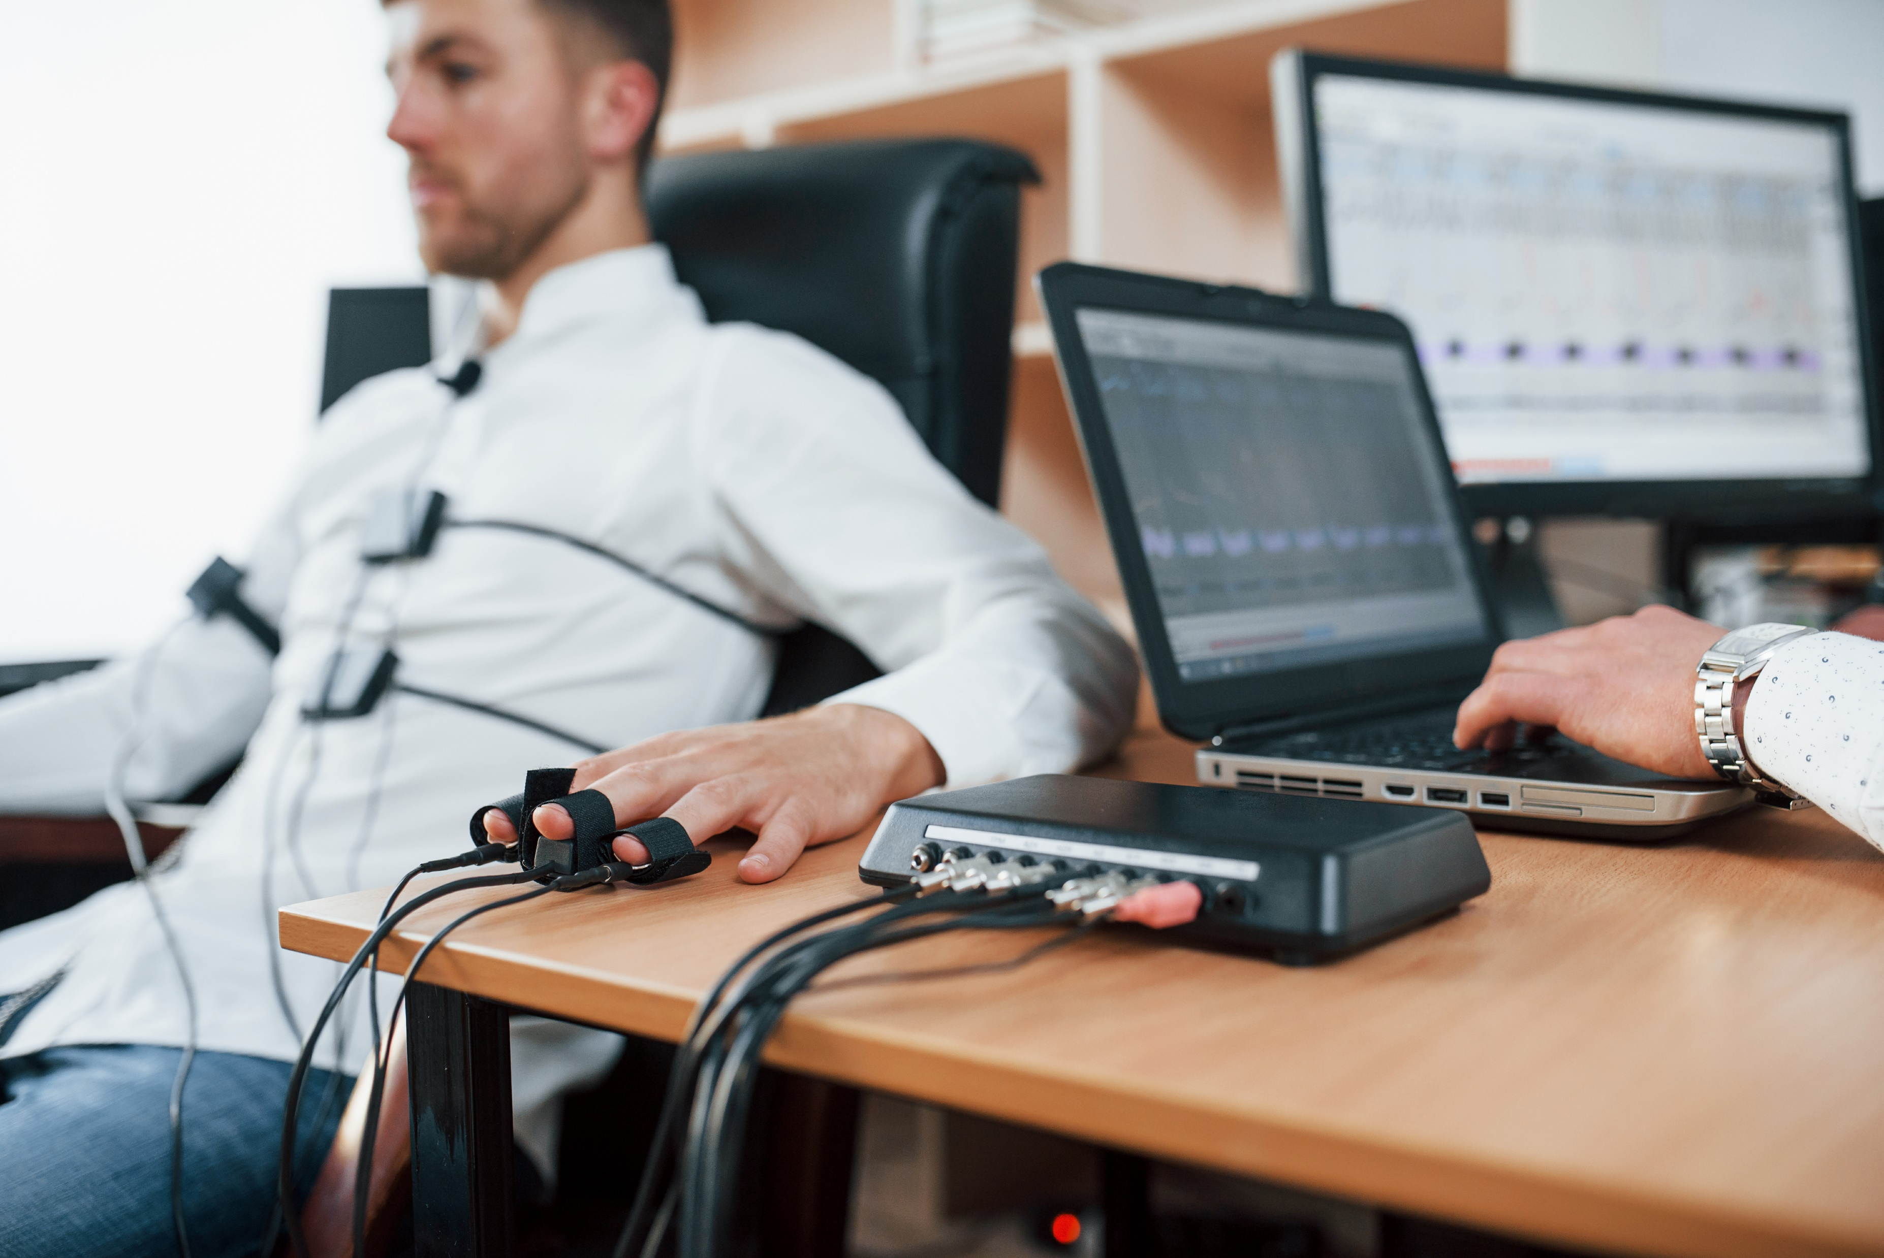
LIE DETECTION DEVICE

Slide 2

TABLE OF CONTENTS
FASFASCSSXSXSXSXSXSX
TABLE OF CONTENTS
S
Lie Detection Test
Components Required
Hardware Model
Arduino Code
Advantages and Disadvantages
Reference Links

Slide 3

The learners will be able to understand how a lie detection device work
What all components are required to make a lie detector device
How both the software and hardware are connected with each other
Pros and cons of the device and how can it be useful

Slide 4
LIE DETECTION TEST
Lie detection is an assessment of a verbal statement with the goal to reveal a possible intentional deceit. Lie detection may refer to a cognitive process of detecting deception by evaluating message content as well as non-verbal cues.It also may refer to questioning techniques used along with technology that record physiological functions to ascertain truth and falsehood in response.
A lie detector test is a device that measures the involuntary physiological changes of a subject’s body as the subject responds to a question or statement. Polygraphs are the most popular lie detector tests used worldwide.
It is based on the assumption that when an individual experiences apprehension, fear, or emotional excitement, his or her respiration rate, blood pressure, and the skin resistance sharply increase.
The goal of lie detection is the discovery of a truth that is known to one person and concealed from others. Psychophysiological lie detection, or polygraphy, is based on the theory that lying produces particular emotions, which produce corresponding measurable physiological responses.

Slide 5
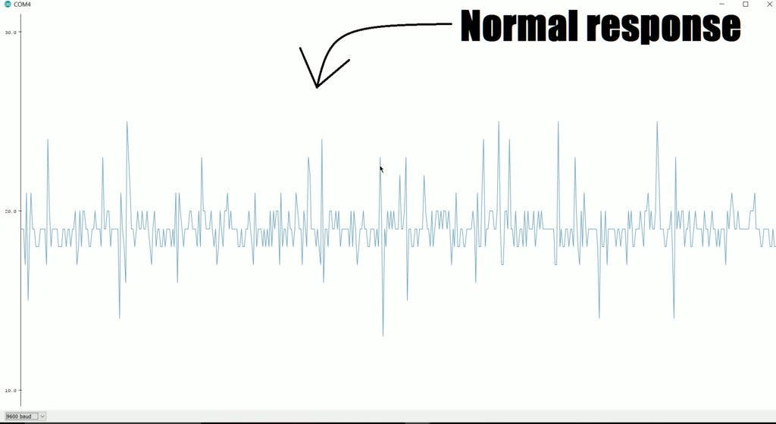
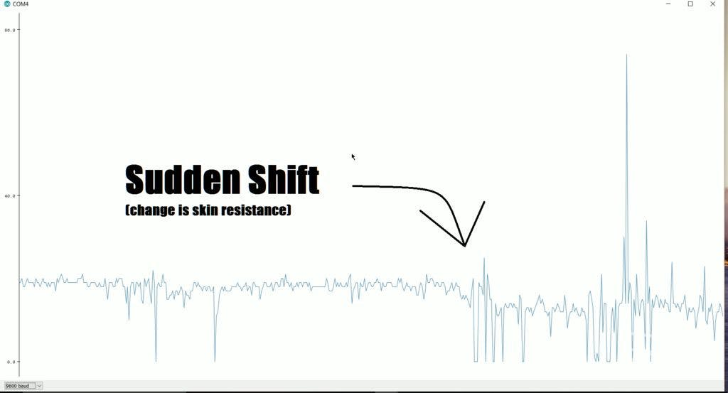
How do these devices work?
These machines detect typical stress responses to telling a lie. This means increased heart rate, blood pressure, and respiration rate. It is an instrument that records an individual's physiological response to a series of structured questions.
The polygraph, invented in the early 1920s, detects physiological responses to lying (such as elevated heart and respiratory rates as well as spikes in blood pressure.
Three main areas of the brain are stimulated during deception: the frontal lobe, the limbic system, and the temporal lobe.
In short, polygraph tests record a number of different bodily responses which can then be used to determine whether someone is telling the truth. They usually measure things like blood pressure, changes in a person's breathing, and sweating on the palms.

Slide 6

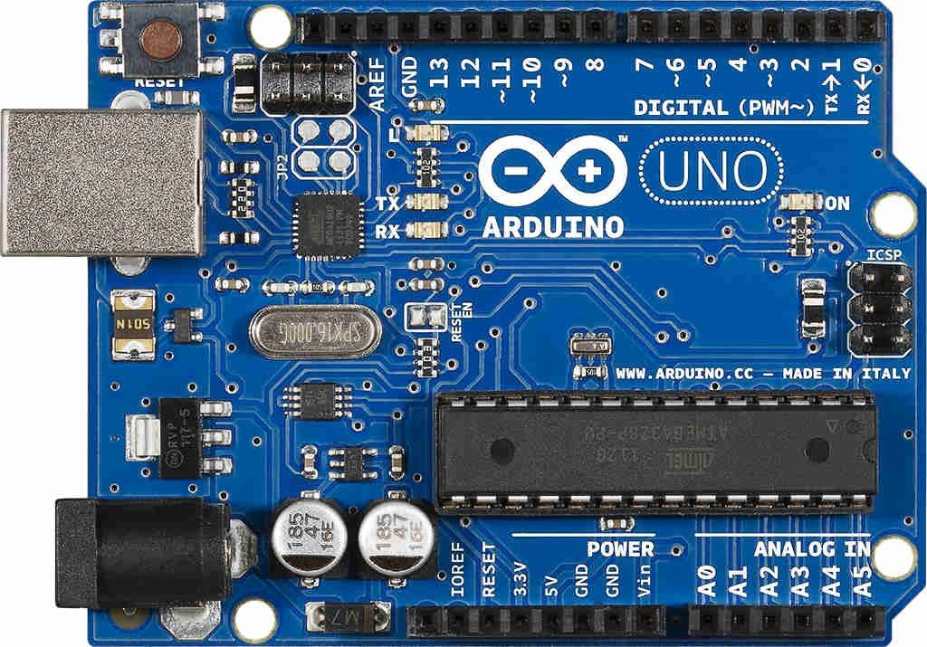
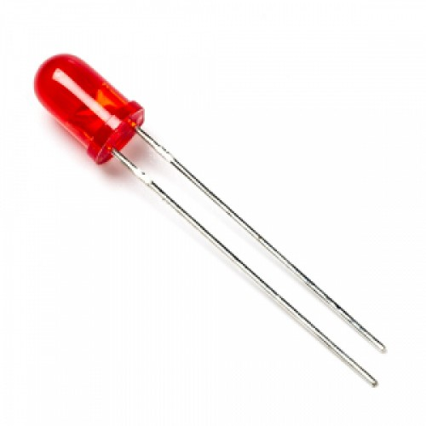
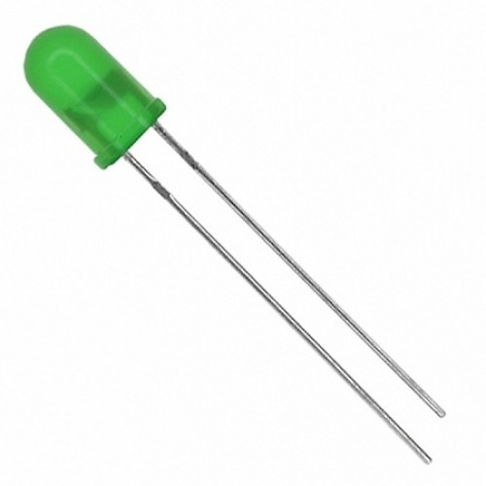
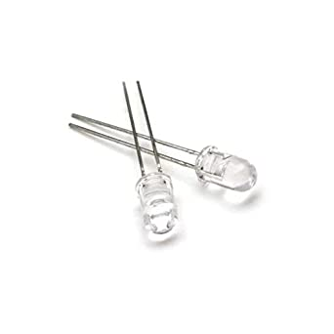
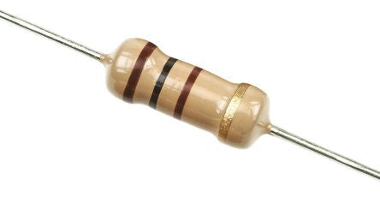
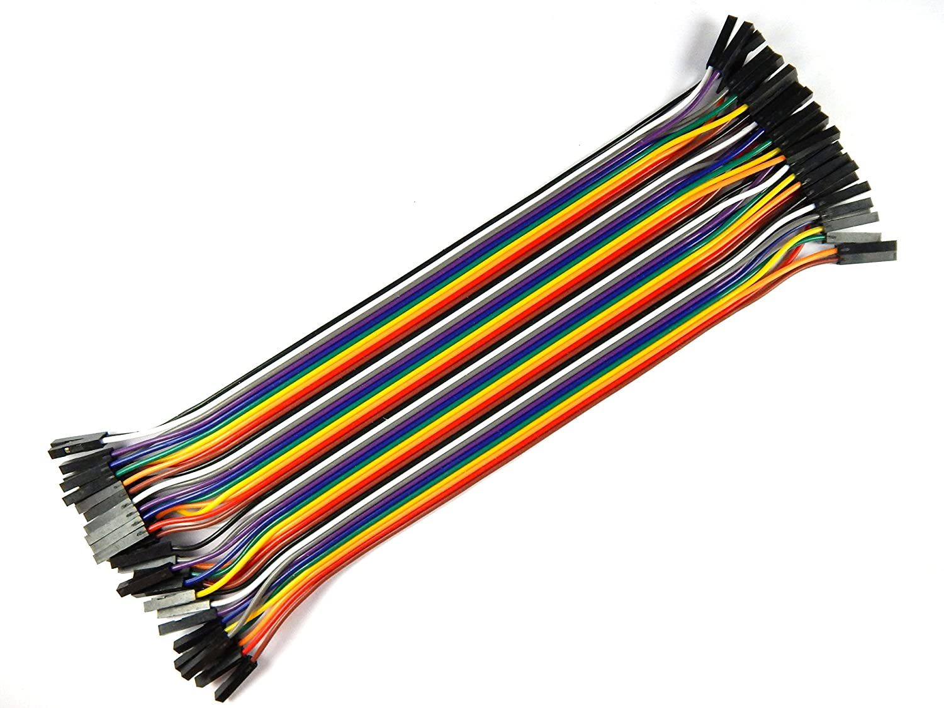

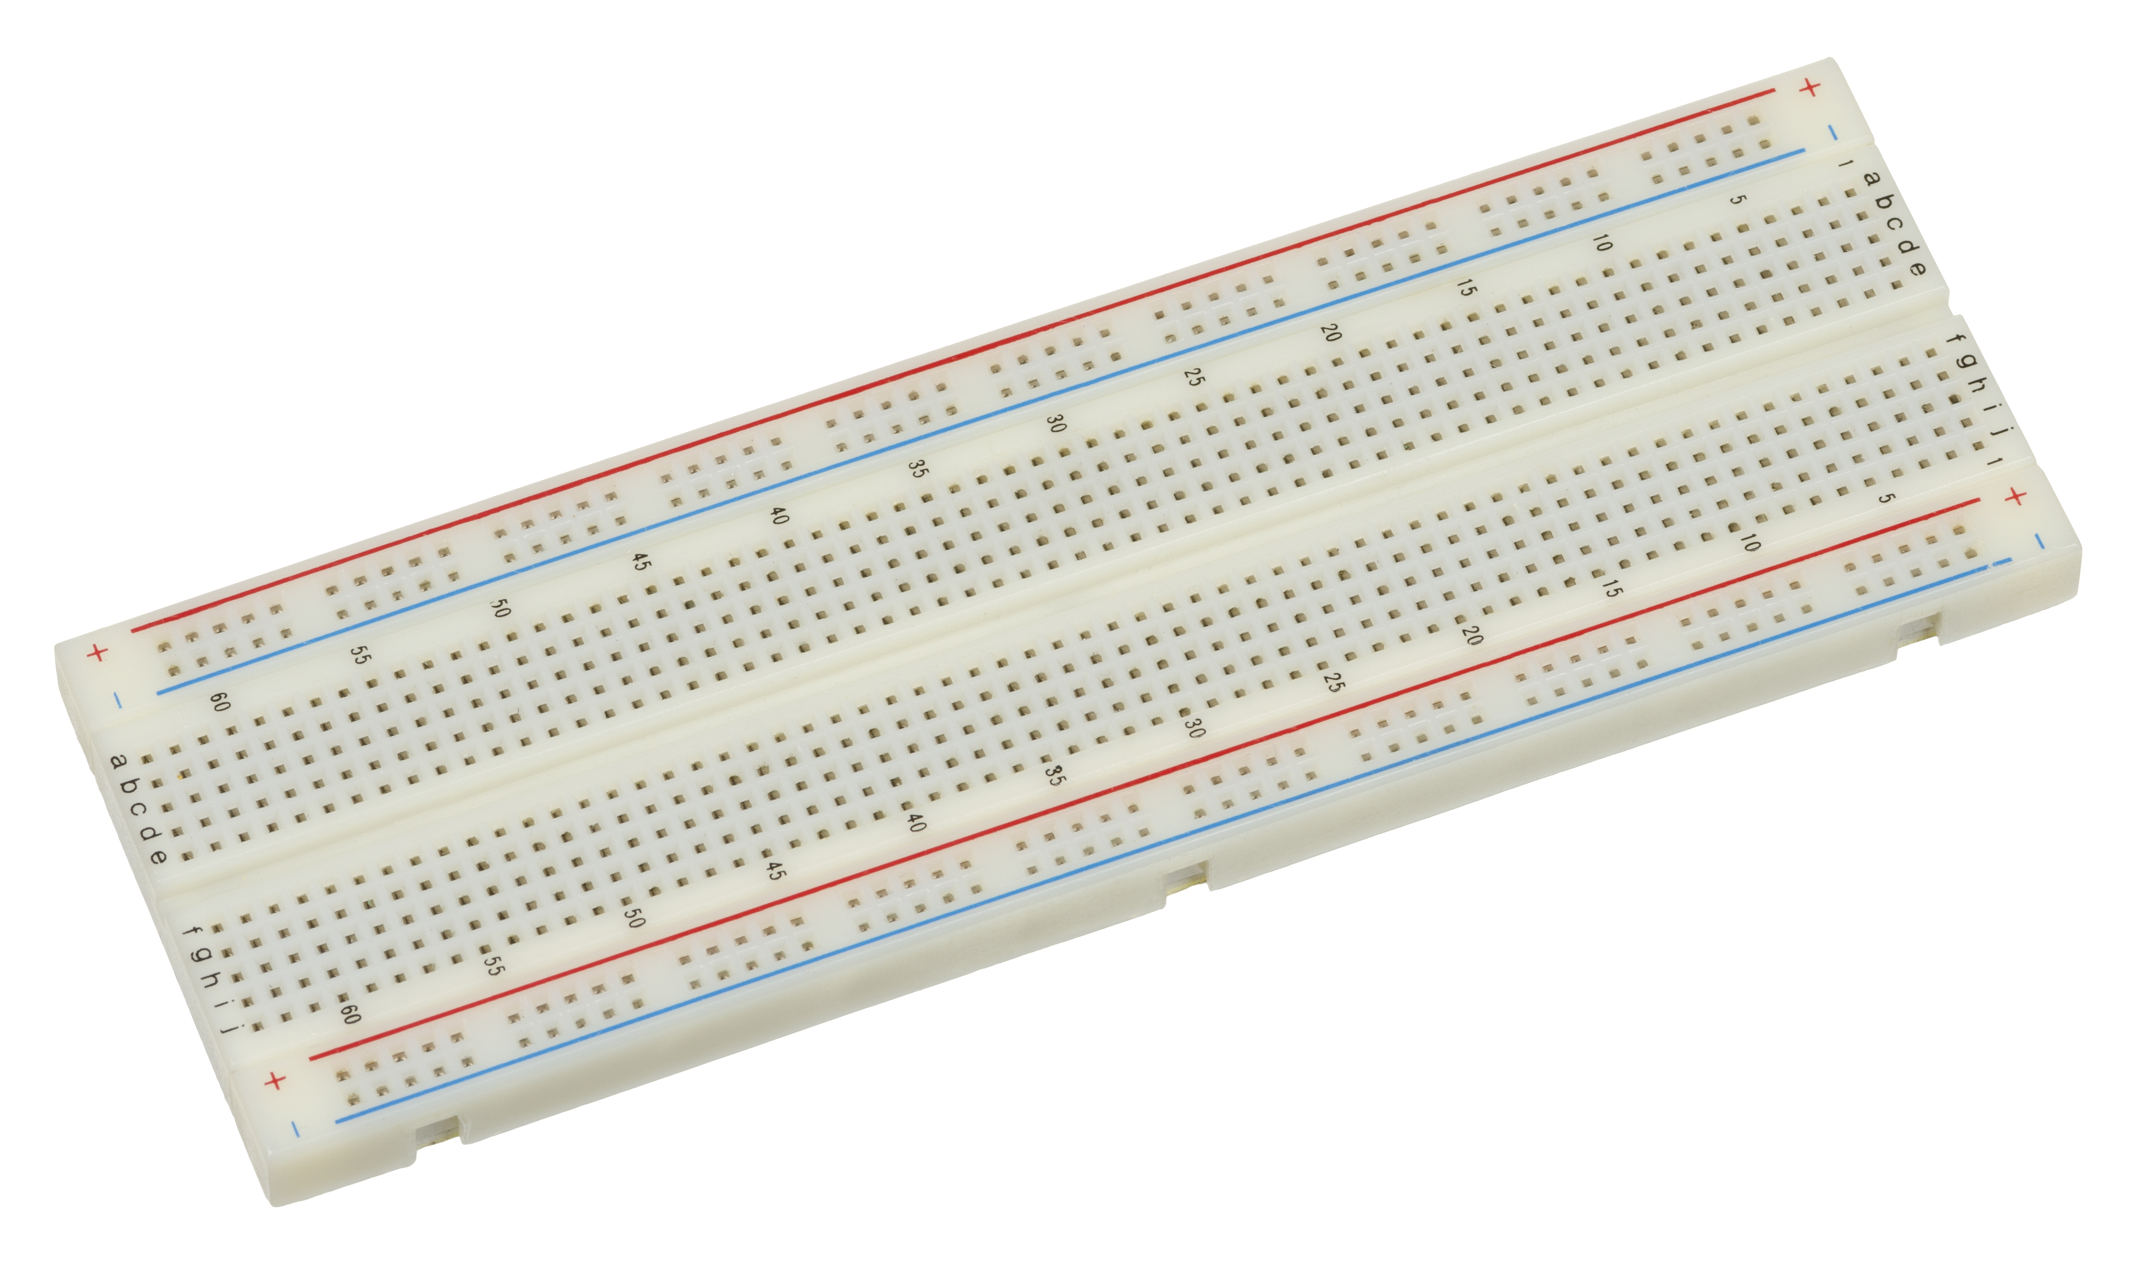
COMPONENTS & SUPPLIES REQUIRED
Arduino Uno
5mm LED: Red
5mm LED: Green
LED Generic
2k Resistor
Jumper Wires
Glue Gun
Breadboard

Slide 7
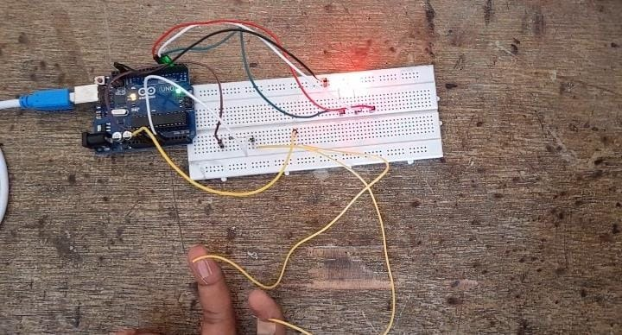
HARDWARE MODEL

Slide 8

ARDUINO CODE

Slide 9
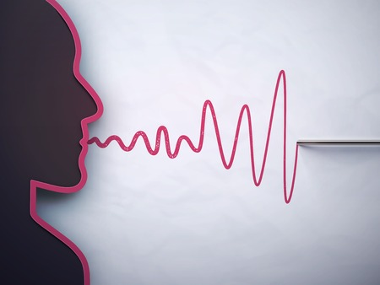
ADVANTAGES
For the criminals it is very easy to fool the law and the security forces by saying lies and easily dodging them, and so in order to confess the truth from them, these agencies uses lie detector machines.
A polygraph test can help in numerous situations to help uncover the truth. They are incredibly useful and accurate, with an average success rate of 90% or higher. There is no pain associated with the test and they are both affordable and accessible.
Polygraph tests have great significance as they have several useful practical applications. They are valuable instruments used to detect truthfulness and deceitful behavior in several fields.
Legacy system with long history of use in law enforcement and military applications; its use has been challenged in court, but in some cases, polygraph testimony has been allowed.

Slide 10
DISADVANTAGES
If the person lies but doesn’t have the stress symptoms of telling that lie, they will pass the test. Similarly, innocent people may fail the test due to being anxious about taking it to begin with and therefore emitting the elevated heart, respiratory, and blood pressure rates that can be detected.
The polygraph is still vulnerable to both physical and psychological countermeasures and it also suffers from a significant error rate based upon inconclusive, false positives, or false negatives results. Manipulation sometimes play a major role from escaping these cases.
Although polygraph tests have certain useful practical applications, there are several challenges. Accuracy and ethics issues are more frequently raised challenges to polygraph tests.

Slide 11
CONCLUSION
Basic science and polygraph research give reason for concern that polygraph test accuracy may be degraded by countermeasures, particularly when used by major security threats who have a strong incentive and sufficient resources to use them effectively. If these measures are effective, they could seriously undermine any value of polygraph security screening,

Slide 12
REFERENCE LINKS
https://create.arduino.cc/projecthub/BuildItDR/arduino-lie-detector-a0b914
https://people.howstuffworks.com/lie-detector.htm
https://en.wikipedia.org/wiki/Polygraph
https://www.britannica.com/story/do-lie-detectors-actually-work
https://spectrum.ieee.org/a-brief-history-of-the-lie-detector
https://science.howstuffworks.com/question123.htm

